Slide 1
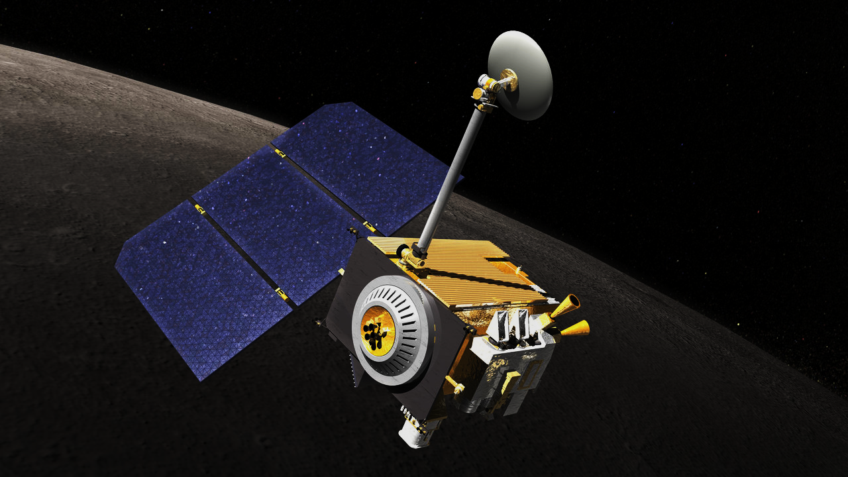
LUNAR RECONNAISSANCE
ORBITER
-Presented By
Jayashree Ahire

Slide 2
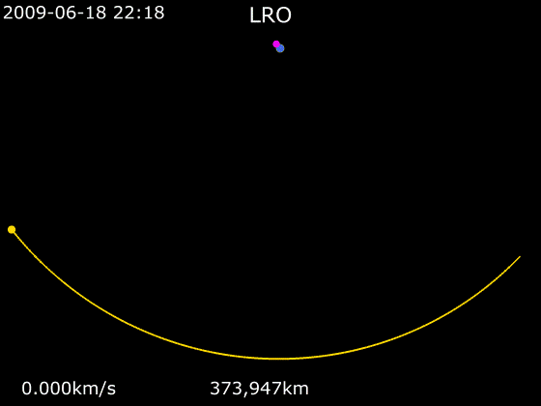
What is LRO?
Multipurpose, robotic NASA spacecraft
Launched on 18 June, 2009
Makes a comprehensive atlas of the Moon’s features and resources
Currently orbiting moon in eccentric polar orbit
Part of the United States' Vision for Space Exploration program
Initially planned for one year
Has since been extended numerous times after review by NASA

Slide 3
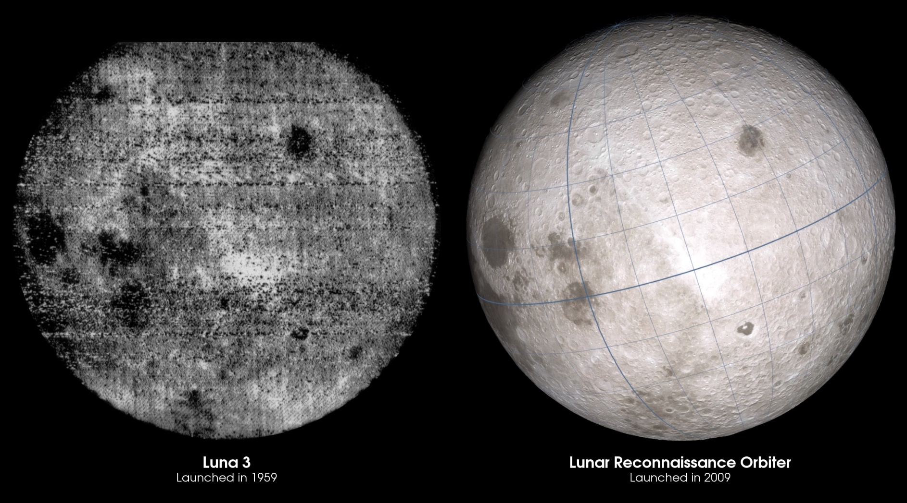

Slide 4
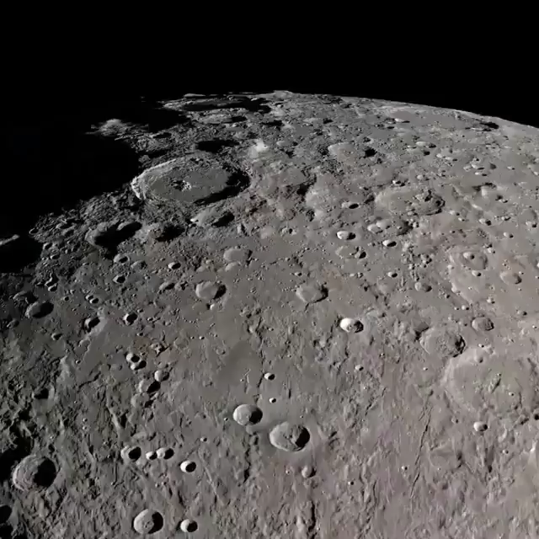

Slide 5
Objectives
To Characterize:
The global lunar radiation environment
Its biological impacts and potential mitigation
Investigation of shielding capabilities
Validation of other deep-space radiation mitigation strategies involving materials
Develop a high- resolutional, 3-D map of the Moon's surface
Provide topography necessary for future landing sites
Detailed assessments of the Moon’s polar regions
High spatial resolution assessment of surface addressing:
Elemental composition
Mineralogy
Regolith characteristics

Slide 6
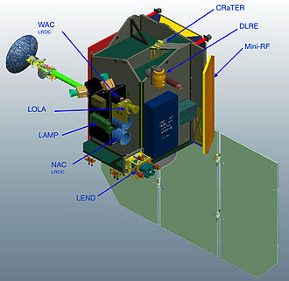
LRO Space craft Instruments

Slide 7
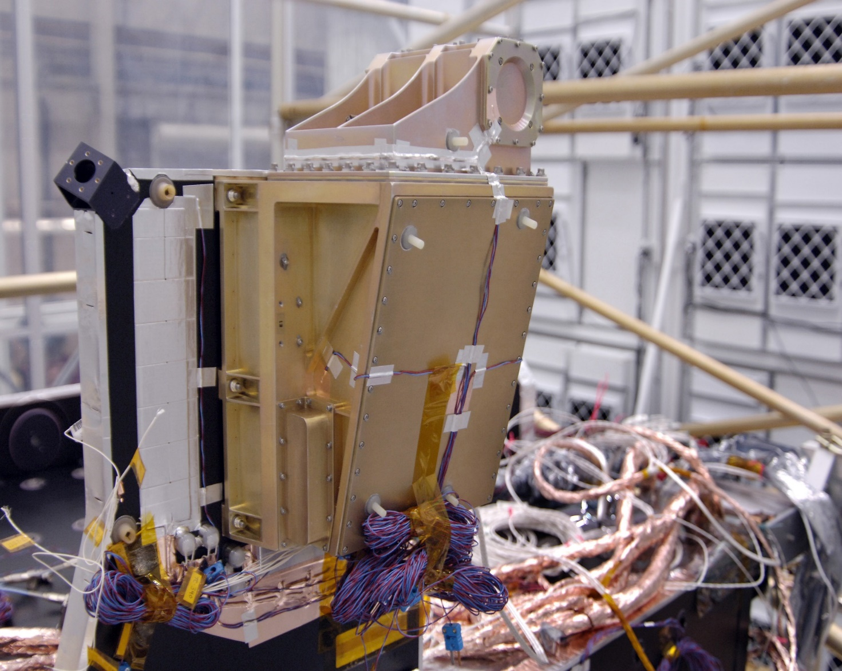
1. Cosmic Ray Telescope for the Effects of Radiation
Built by Boston University and Massachusetts Institute of Technology
Studies Lunar Radiation Environment
Tests effects of radiation on models
Measures radiation absorption on a special type of plastic tissue
Results will help keeping future lunar crew members safe
Measures galactic and solar cosmic ray radiation behind a "human tissue-equivalent" plastic
Discovered a previously unmeasured source of hazardous radiation coming from the moon itself

Slide 8
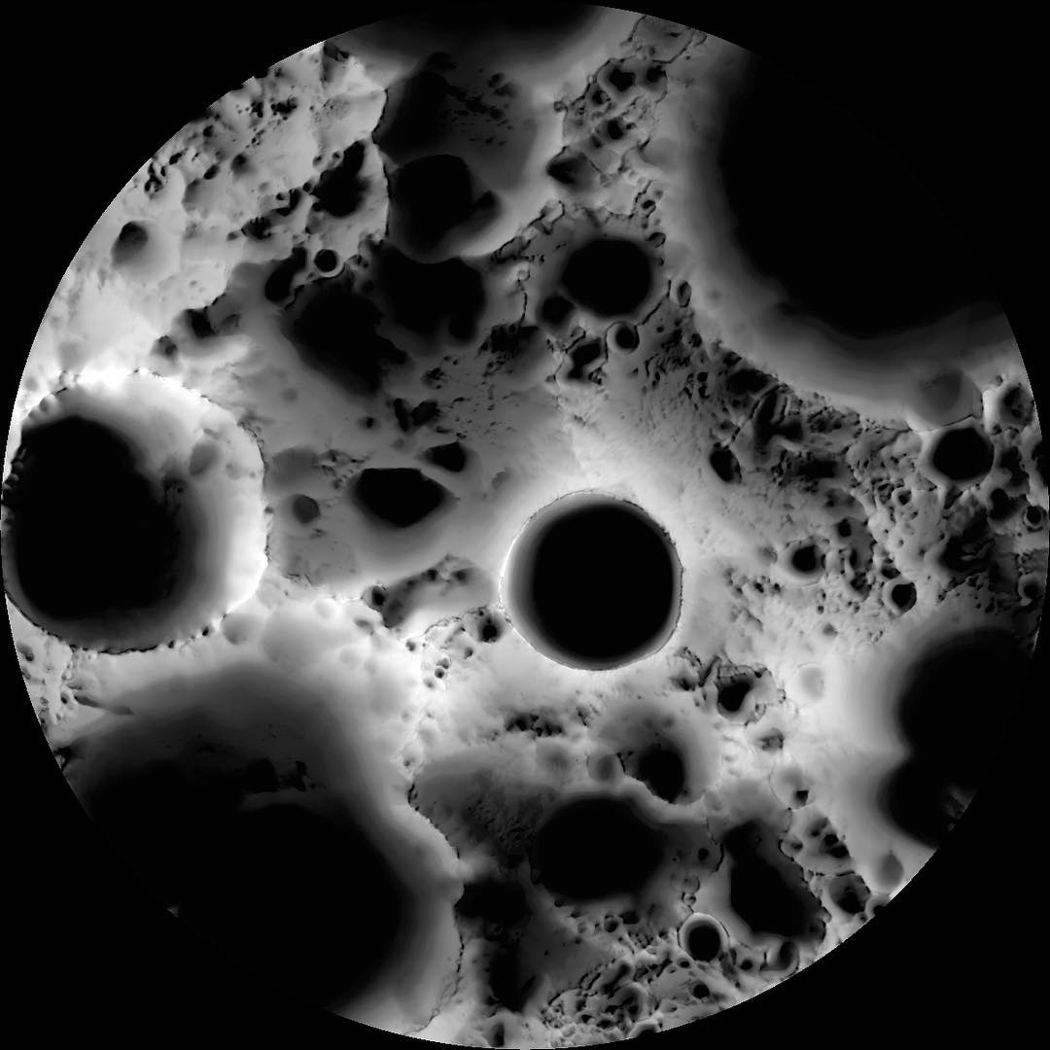
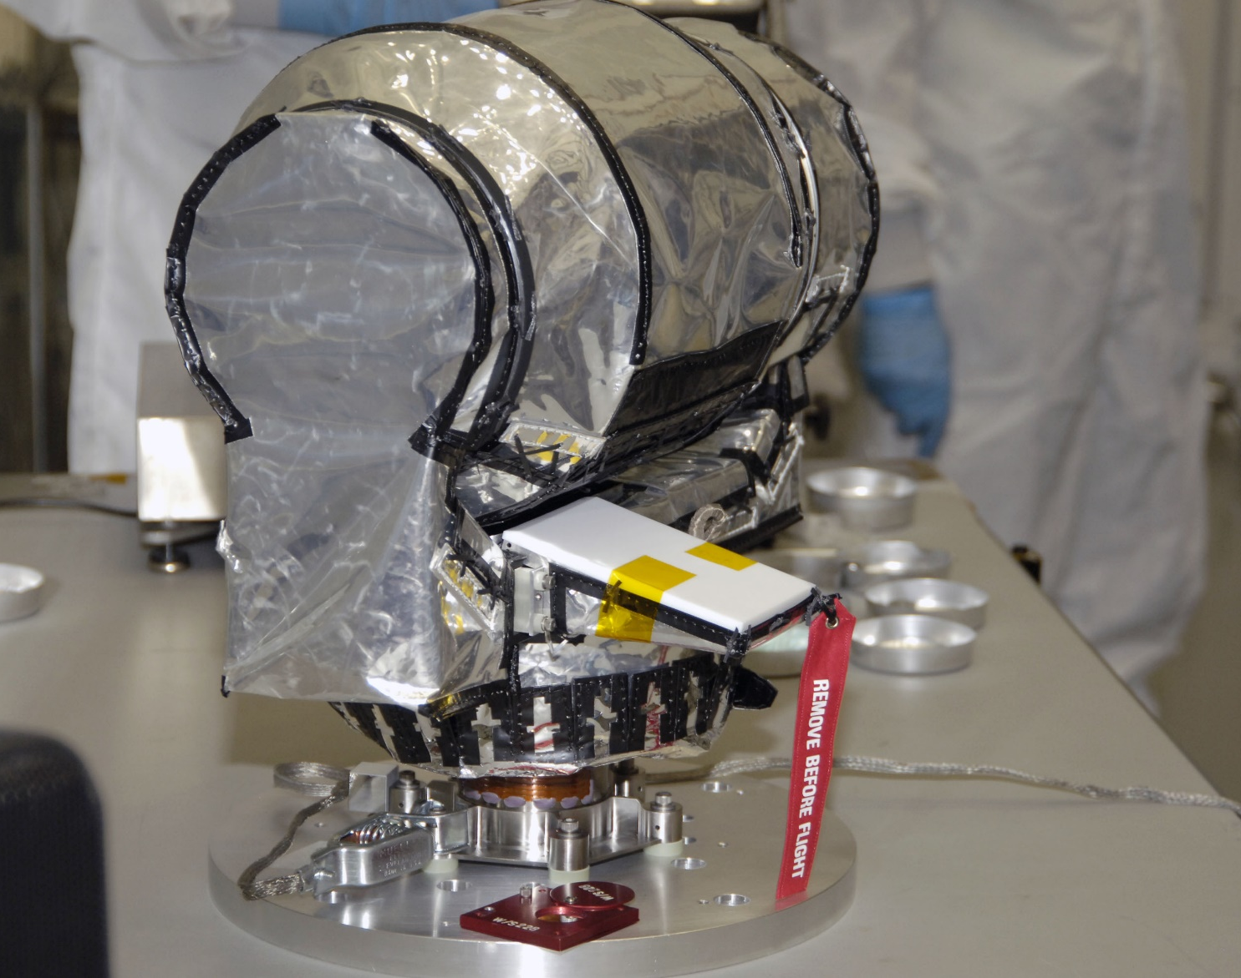
2. Diviner Lunar Radiometer Experiment
Built and developed by University of California, LA and NASA’s JPL, Pasadena
Measures subsurface temperature and thermal emissions
Identifies
Cold traps
Potential ice deposits
Rough Terrain
Landing hazards
Revealed the presence of lunar soils with compositions more sodium rich than that of the typical crust.
Identified quartz, silica-rich glass, and alkali feldspar at four of these unique, nearside sites.
Multi-temporal illumination map of the lunar south pole, Shackleton crater (19 km diameter) is in the center

Slide 9
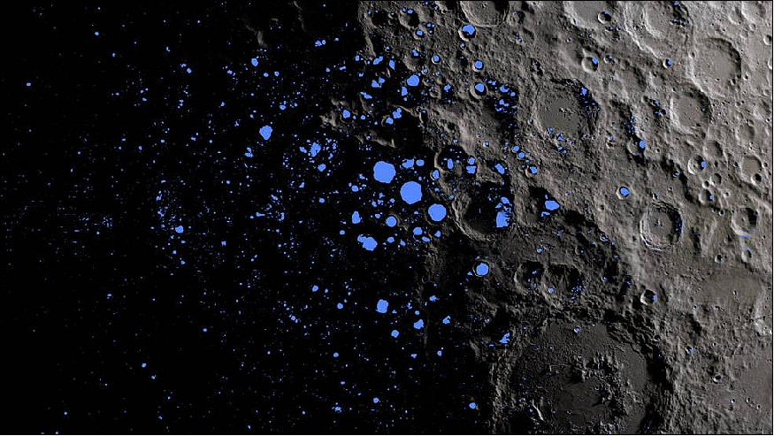
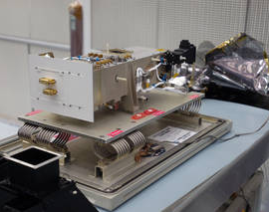
3. Lyman-Alpha Mapping Project
Built and developed at the Southwest Research Institute in San Antonio
Searches for surface ice and frost in the polar regions
Provides images of permanently shadowed regions
Uses Ultraviolet starlight and the glow of interplanetary hydrogen emission, the Lyman-Alpha line
At the southern pole, most of the ice is concentrated at lunar craters
Northern pole’s ice is more widely, but sparsely spread
A map showing the permanently shadowed regions (blue) that cover about three percent of the moon's south pole (image credit: NASA Goddard/LRO mission)

Slide 10
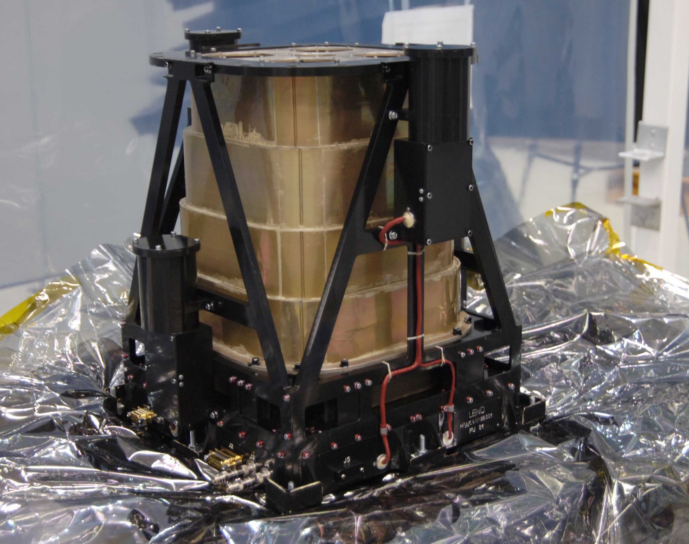
4. Lunar Exploration Neutron Detector
Developed at the Institute for Space Research in Moscow
Creates high-resolution maps of hydrogen distribution
Gathers information about the neutron component of the lunar radiation environment
LEND data is analyzed to search for evidence of water ice near the moon’s surface

Slide 11
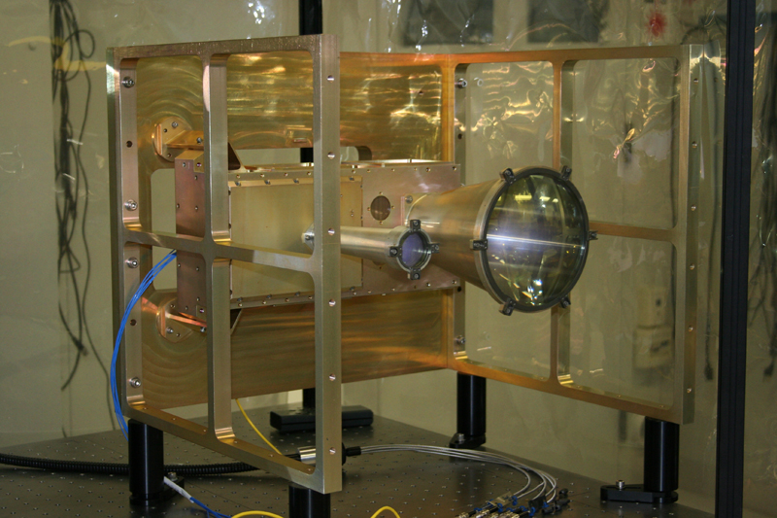
5. Lunar Orbiter Laser Altimeter
Conceived and built by scientists and engineers at NASA's Goddard Space Flight Center
Measures the slope of potential landing sites and lunar surface roughness
Generates a high-resolution, 3-D map of the moon
Measures and analyzes the lunar topography
Identifies permanently illuminated and permanently shadowed areas
Looks for solar power station
At some point you would be doing nothing but counting craters for the rest of your life
- James Head

Slide 12
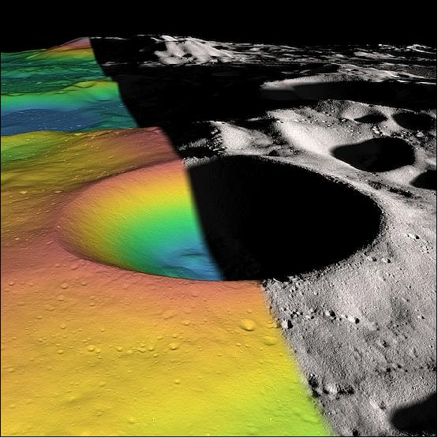
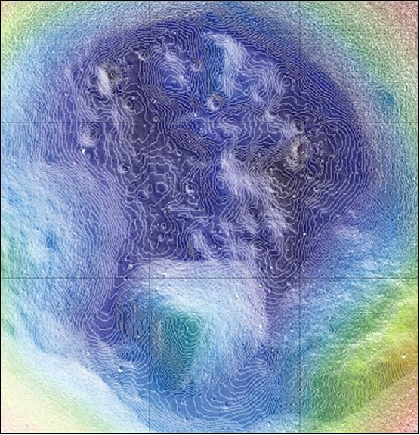
High-resolution map showing the topography in the interior of the Shackleton crater as observed by LOLA (image credit: MIT, NASA)
Elevation (left) and shaded relief (right) image of the Shackleton Crater (image credit: NASA, MIT)

Slide 13
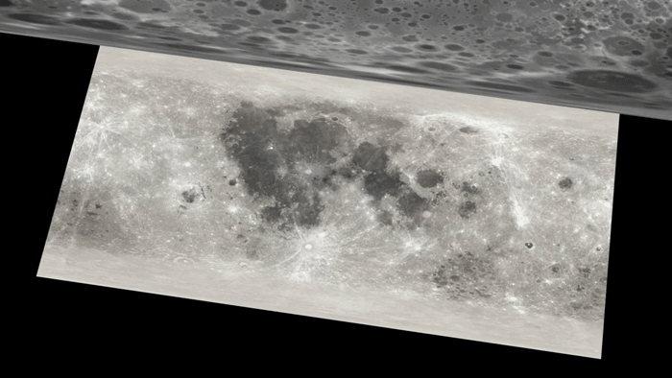

Slide 14
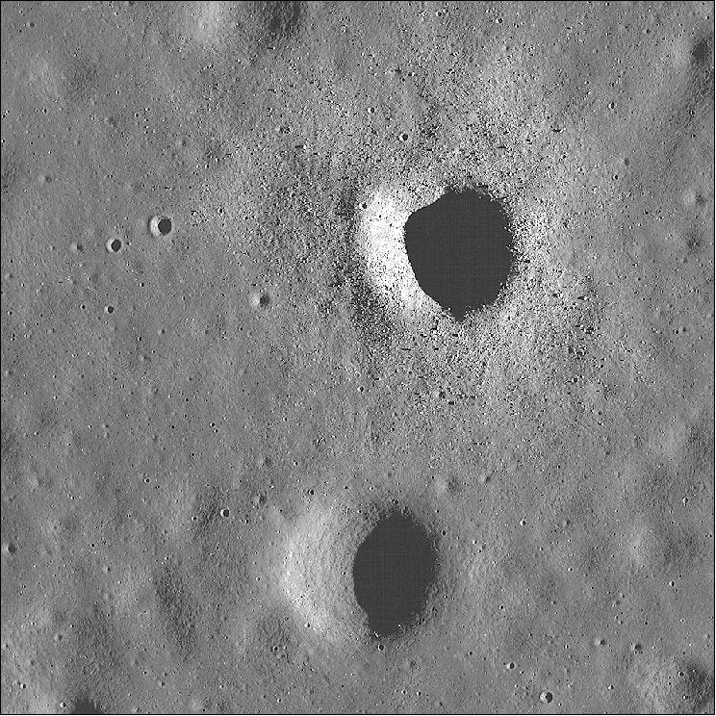
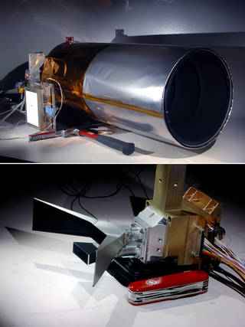
6. Lunar Reconnaissance Orbiter Camera
Developed at Arizona State University in Tempe
Two narrow-angle cameras
Make high-resolution, black-and-white images of the surface
Capture images of the poles with resolutions down to 1 meter (about 3.3 feet)
A third, wide-angle camera (WAC)
Takes color and ultraviolet images over the complete lunar surface at 100-meter (almost 330-foot) resolution
These images show:
Polar lighting conditions
Identify potential resources and hazards
Aid selection of safe landing sites.
A 2014 LROC (Lunar Reconnaissance Orbiter Camera) image showing two similarly sized craters in Mare Tranquillitatis. Both are about 500 meters in diameter. One is littered with boulders and the other is not. This boulder discrepancy is likely due to age differences between the two craters. Image width is about 2 kilometers. North points up (image credit: NASA/GSFC/Arizona State University)

Slide 15
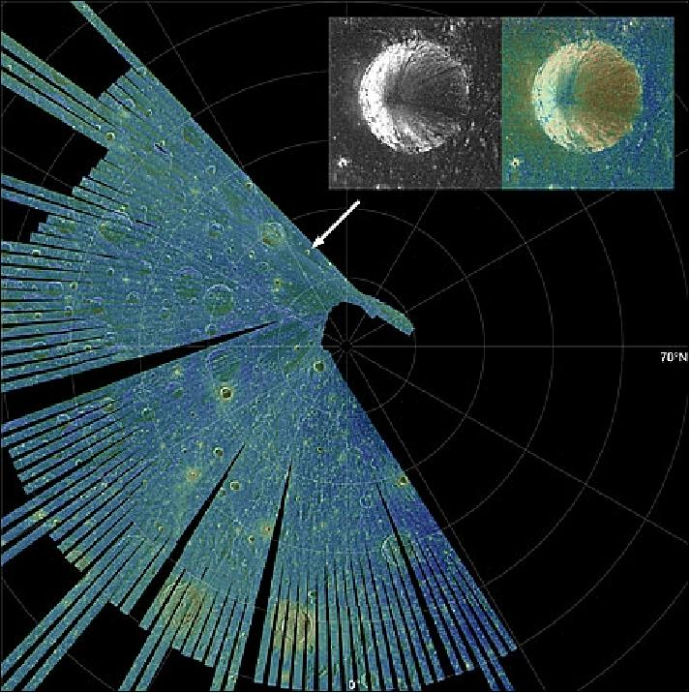
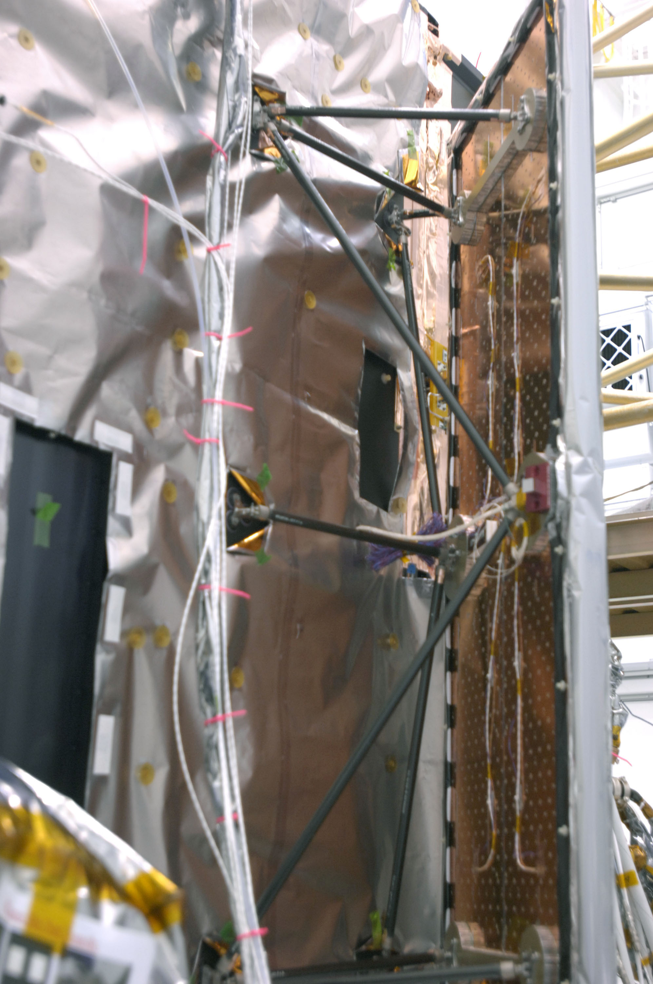
7. Mini- RF
The Miniature Radio Frequency radar
Used to image the polar regions using SAR(Synthetic Aperture Radar)
Locates potential water- ice
Demonstrate the ability to communicate with an Earth-based ground station
Collected more than 400 strips of radar data since Sept 2010
Underwent anomaly during Jan 11
Collects bistatic radar observations
The SAR instrument Mini-RF returns first high-resolution view of an unusual crater near the moon's north pole (image credit: NASA)

Slide 16
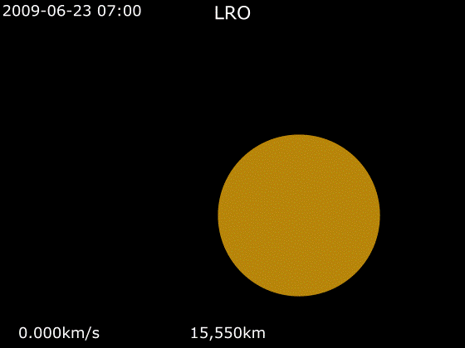
Success Stories/ Achievements

Slide 17
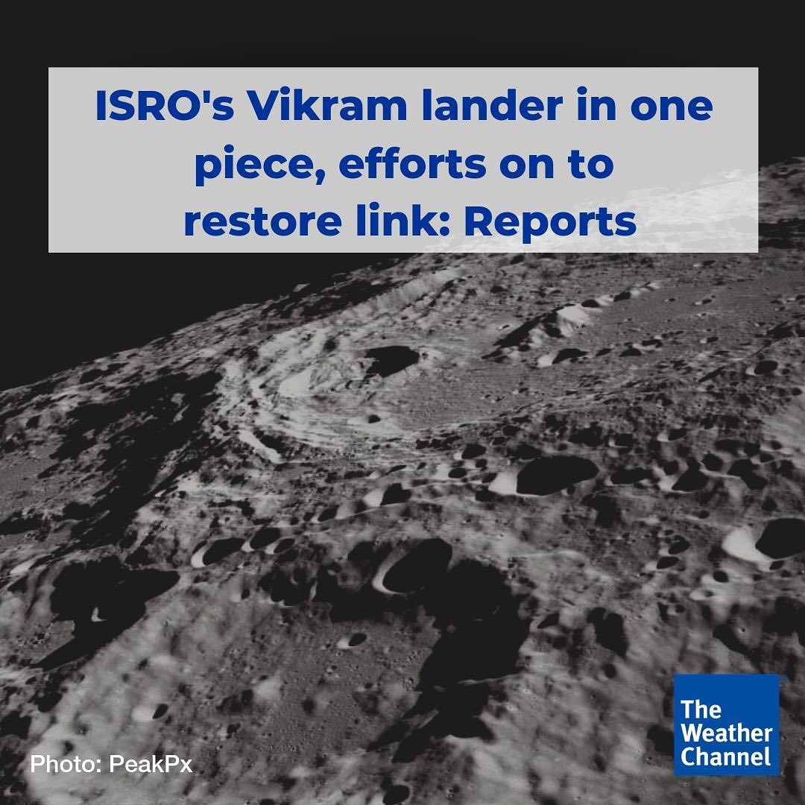
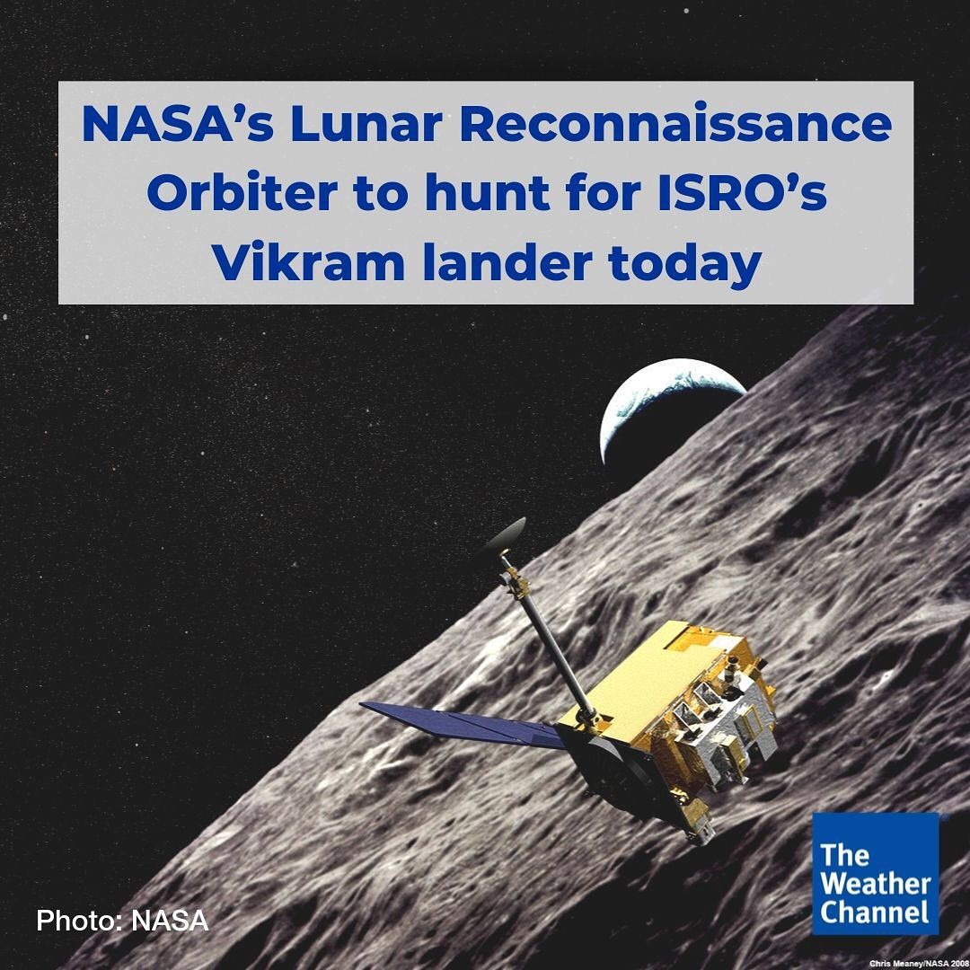

Slide 18
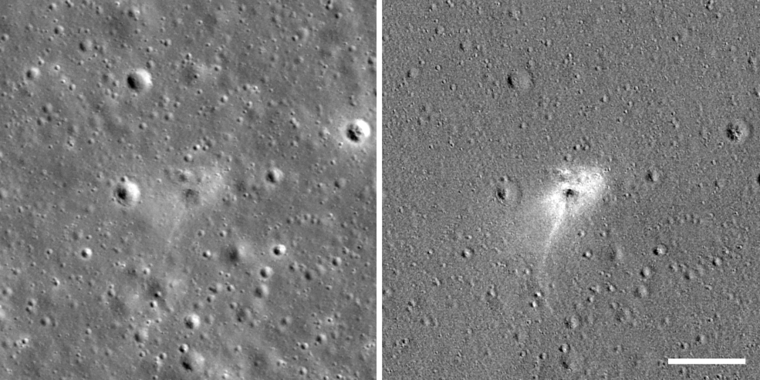
Left: Beresheet impact site. Right: An image processed to highlight changes near the landing site among photos taken before and after the landing, revealing a white impact halo
Image Credits: NASA

Slide 19
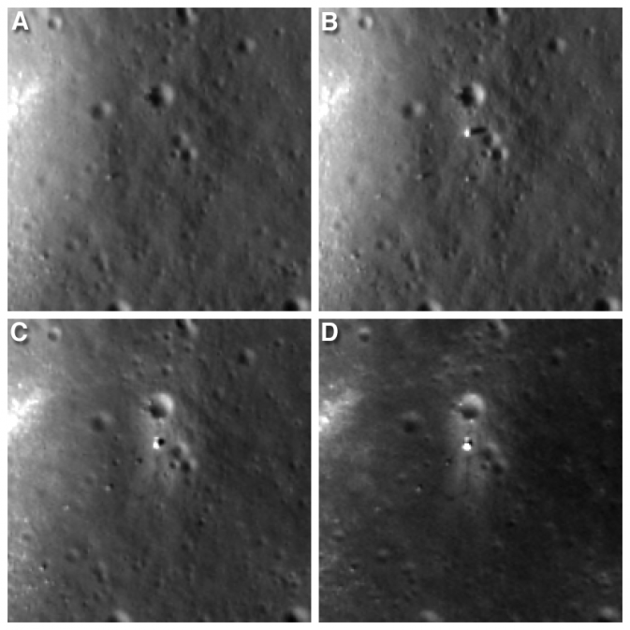
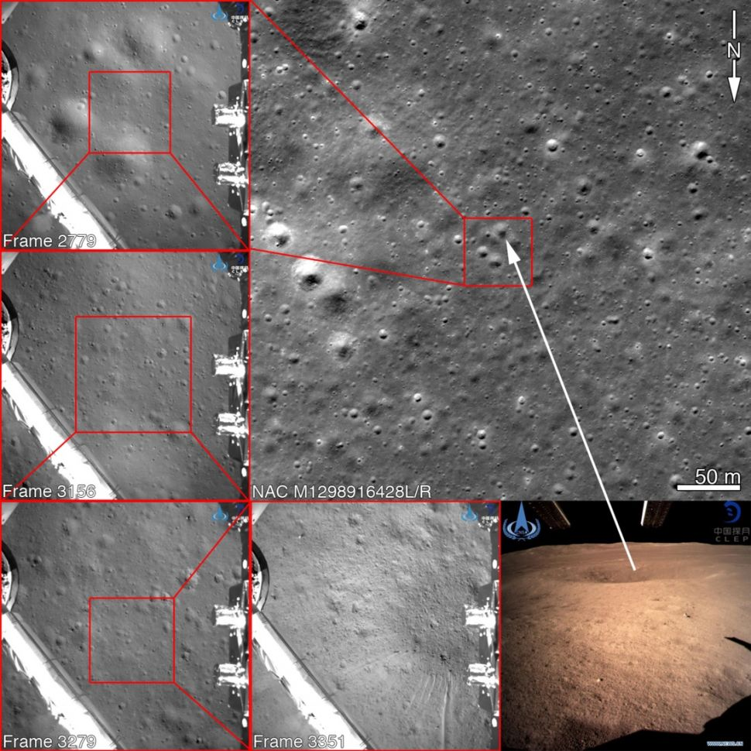
Four LROC NAC views of the Chang'e 3 landing site. A) before landing, June 30, 2013 B) after landing, Dec. 25, 2013 C) Jan. 21, 2014 D) Feb. 17, 2014 Width of each image is 200 meters (about 656 feet). Follow Yutu's path clockwise around the lander in "D."
Image Credit: NASA/Goddard/Arizona State University
Upper right: Image captured by NASA's Lunar Reconnaissance Orbiter showing the landing site of China's Chang'e 4 mission to the moon's far side. The photo was taken before Chang'e 4's Jan. 2 landing. Chang'e 4 took the descent photos at left and the image from the surface at lower right

Slide 20
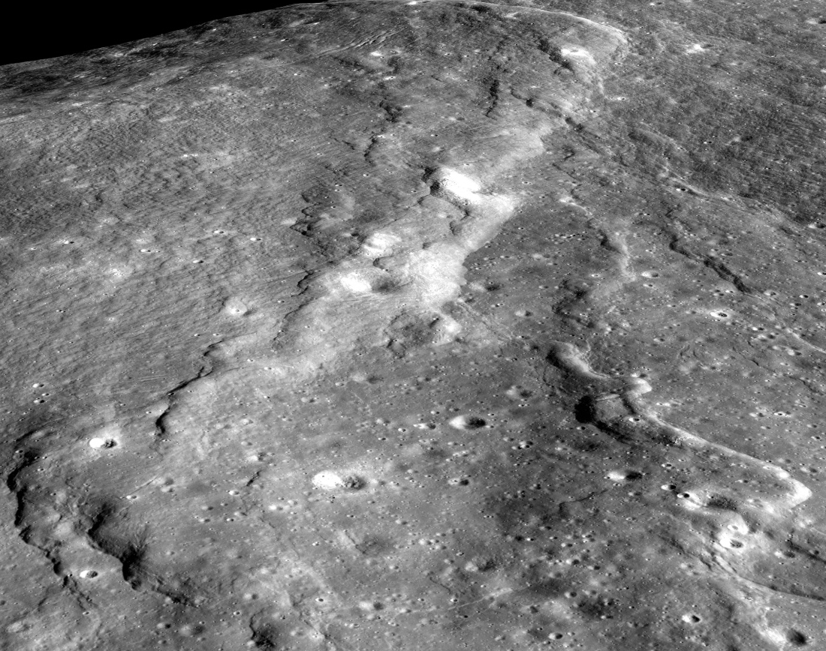
1. It's shrinking and quaking
The Moon, long thought to be a dead, inactive world, is still losing heat and, as a result, shrinking
As it continues to slowly cool off, the Moon’s crust, or outer layer, is shriveling
Moon has lost 150 feet (50 meters) of width over hundreds of millions of years, scientists estimate
This shrinking, plus the stress on the Moon’s outer layer produced by the tugging of Earth’s gravitational pull, cracks the Moon’s crust and leads to moonquakes
Some are fairly strong, reaching level 5 on the Richter scale used to measure earthquake
This is a wrinkle on the surface of the Moon, called a lobate scarp, caused by shrinking and cooling
This image combines data from two of LRO’s instruments: the Lunar Orbiting Laser Altimeter (LOLA) and the Lunar Reconnaissance Orbiter Camera (LROC) to create a precise digital terrain model
Lobate scarps can tell us about how hot the Moon was when it was born and its ongoing thermal evolution. Image width is about four kilometers.
Credit: NASA/GSFC/Arizona State University

Slide 21
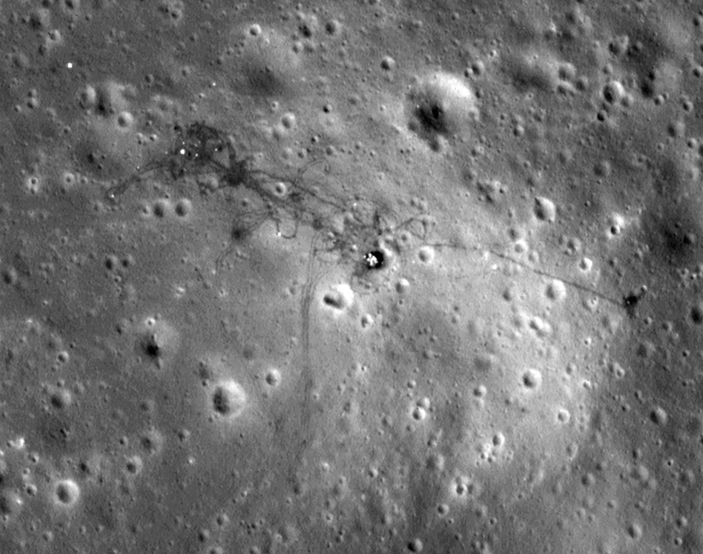
2. It had active volcanos more recently than we thought
3. The far side of the Moon is older than the side we see
5. It gets unimaginably cold
6. Instead of a dry, dead rock, the Moon is a dynamic and wet world
7. It preserves footprints for a long time
8. The South Pole region is a wondrous land that we want to explore
Besides water, we’ve learned that the South Pole has other features that are beneficial to human exploration, such as prolonged periods of sunlight
More than 200 Earth days of constant illumination at the southern pole means ample power for solar panels on rovers and other equipment.
9. We know its surface in more detail than any other celestial body, including our own planet
10. It has underground safe havens that could protect astronauts from radiation
This image taken by LRO in 2010 depicts the tracks that Apollo 15 astronauts David Scott and James Irwin made 39 years previously. The Moon has no atmosphere, and thus no wind or rain to sweep the footprints away.
Credit: NASA/GSFC/Arizona State University

Slide 22
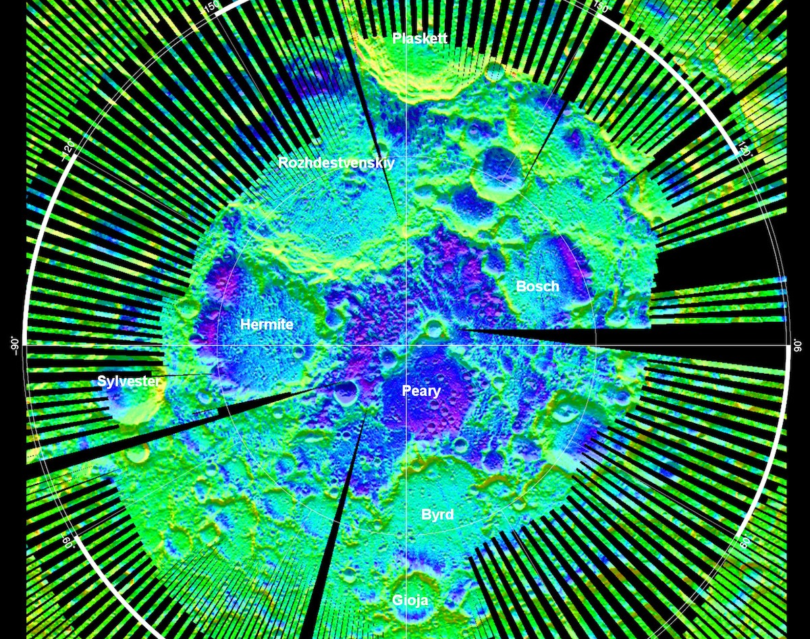
4. Its craters provide a timeline of solar system history
LRO data has allowed scientists to construct a timeline of asteroid bombardment history on the Moon, providing insight not only into the Moon's formation, but of the whole solar system
Since the Moon doesn’t have wind, storms and plate tectonics, its craters don’t get eroded away like Earth’s do
Using tools on LRO, scientists can count and age them
By doing so, we can look back billions of years at the mayhem of the early solar system, when giant collisions were jostling planets and their satellites
This temperature map of the Moon’s north pole shows chilly Hermite crater, the coldest-measured spot not just on the Moon, but across the entire solar system.
Credit: NASA/GSFC/UCLA

Slide 23
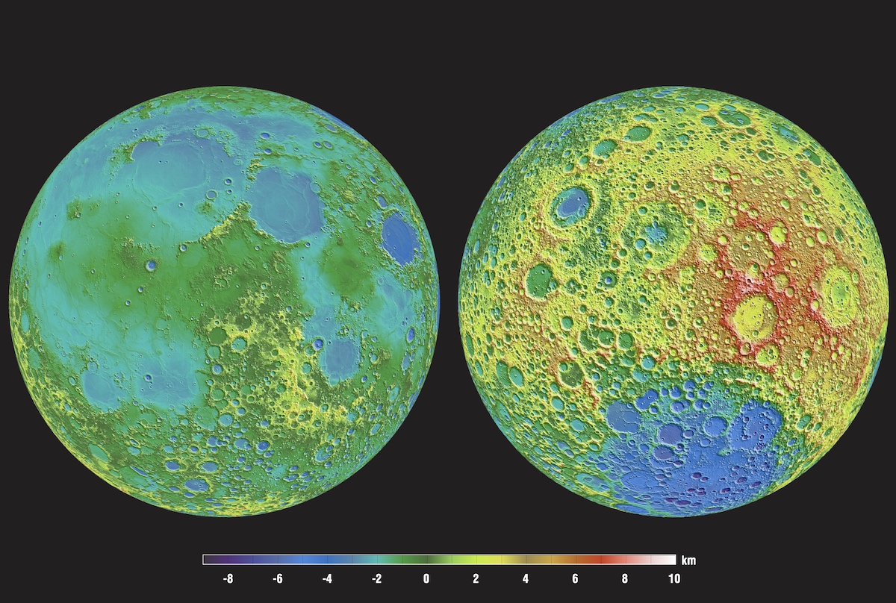
The first highly accurate 3D Lunar Maps
Provided data for the highest resolution near-topographical map of the Moon to date
Acquired stereo images of the moon in high resolution (0.5 to 2 meters/pixel)
Provided 3-D views of the surface
High resolution topographic maps are made from those views
(LROC NAC) team- currently developing a processing system to automatically generate anaglyphs from most of these stereo pairs
The LROC NAC anaglyphs make lunar features such as craters, volcanic flows, lava tubes and tectonic features jump out in 3-D.
This false color image depicts elevation on the Moon, with the red and white areas indicating higher elevations and purple indicatingas lower ones. The data comes from LRO's LOLA instrument, which shoots a laser at the surface of the Moon and measures how long it takes for the light to bounce back.
Credit: NASA/GSFC/MIT

Slide 24
Mapping Mineralogy Across the Moon
The crust of the Moon is made up of two main types of rock:
Anorthosite:
light in color
Made up of a light-colored mineral called plagioclase feldspar.
Basalt
dark in color
contains the iron-bearing minerals pyroxene, olivine and ilmenite, along with volcanic glass.
Iron present in these minerals tend to absorb light, making them appear dark.
Light and dark areas on the Moon are composed of these rock types.
Possibilities Predicted:
Variations in the chemistry and cooling rate of the magma ocean formed the early lunar crust
Could be the result of secondary processing of the early lunar crust.

Slide 25
What has it looked for
Measured the coldest temperatures in the solar system inside the Moon’s permanently shadowed craters
Detected evidence of water ice at the Moon’s south pole
Seen hints of recent geologic activity on the Moon
Found newly-formed craters from present-day meteorite impacts
Tested space borne laser communication technology
and much more…..

Slide 26
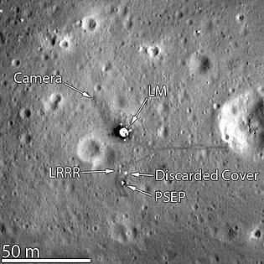
Assessment of Features for Landing Sites
The historic spacecraft serves as benchmarks
Each image adds to our knowledge of
lunar science and engineering
cartography
geology
photometry
Making sure that the lunar cartographic network is accurate is a critical component for planning future lunar missions for both human and robotic exploration of the Moon
When new images arrive and final ephemeris is in hand we can check if the hardware has moved

Slide 27
Searching for Polar Volatiles
Particularly focuses on the moon's poles to search for water or ice that could exist in permanently shadowed craters
Discovering water on the moon would be like finding a gold mine
In fact, scientists have discovered evidence for water or hydrogen, a component of water, in special places on the moon
Since the moon is not tilted much from its rotation axis, the depths of certain craters in the lunar poles may not have seen the sun for billions of years

Slide 28
What’s so special?
Previous crater counts had relied on less uniform data
Collections of photographs taken at different lighting angles that changed the craters' shadow profiles
Carried out the first demonstration of laser communication with a lunar satellite
It's the first time a homogeneous data set of the entire moon, front and back, has been examined from the point of view of crater distribution

Slide 29
THANK YOU!
"Before LRO, we actually knew the shape of Mars better than we knew the shape of the moon, our nearest neighbor. Because of LRO, we now have detailed maps of both the near side and far side of the moon."
- John Keller, LRO Project Scientist

